Slide 1
人工智能 风起时 Data Mining for Cybersecurity
蓝盾人工智能实验室
Bluedon AI Lab
Notes:
在网络安全下的数据挖掘
Action Plan:
* 蓝盾云应该开始收集数据

Slide 2
Principles & Hot Trends 原则 & 热门趋势

Slide 3
It is time to Shift from Rules/Patterns/Regular Expressions to Artificial Intelligence

Slide 4
从 规则 到 人工智能 的华丽转变

Slide 5
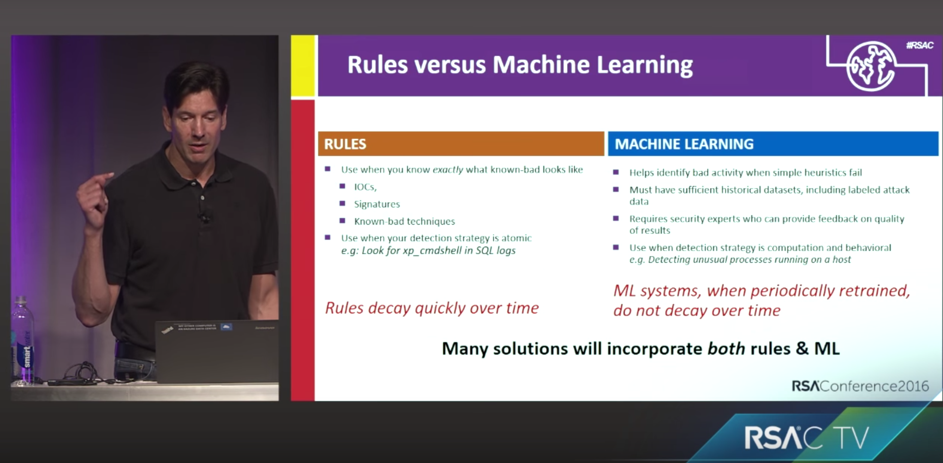
Notes:
Self maintaining or baby sitting

Slide 6
Hybrid Solution is fitted for Bluedon (Firewall)

Slide 7
Any cybersecurity problems based on Rules can be transformed to an corresponding AI Problems
Notes:
Phishing Detection (For how to apply, please see cs259d -> 19)
Network Intrusion Detection (For how to apply, please see cs259d -> 15)
Botnets (For how to apply, please see cs259d -> 2,3)

Slide 8
Data is the new king in Cybersecurity & AI, without data, there is NO AI at all

Slide 9
So, please make our Honeypots & red team ready and start collecting data

Slide 10
Bluedon Research Collection: All Free & Open Source
For Intro & Code & Papers, please visit:
https://github.com/weijiang2009/Bluedon
For the latest Malware Dataset, please visit:
http:// 172.16.7.46:50070/explorer.html#/dataset
For 1999 KDD Intrusion Detection Dataset, please visit:
http://172.16.7.46:50070/explorer.html#/dataset2
For Current Big Data Interactive Notebook, please visit:
http://172.16.7.46:9001/

Slide 11
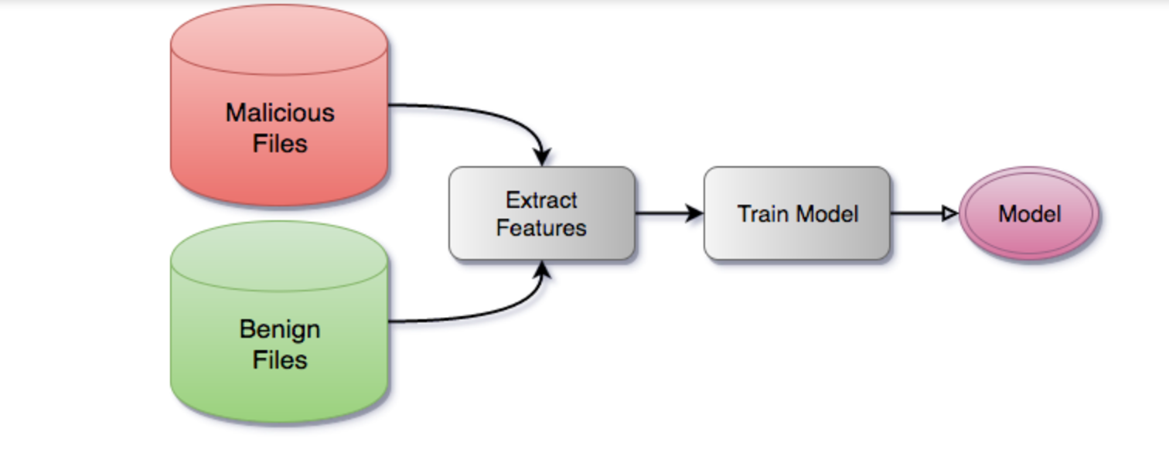
Training Phase
Notes:
SentinelOne malware detection engine

Slide 12
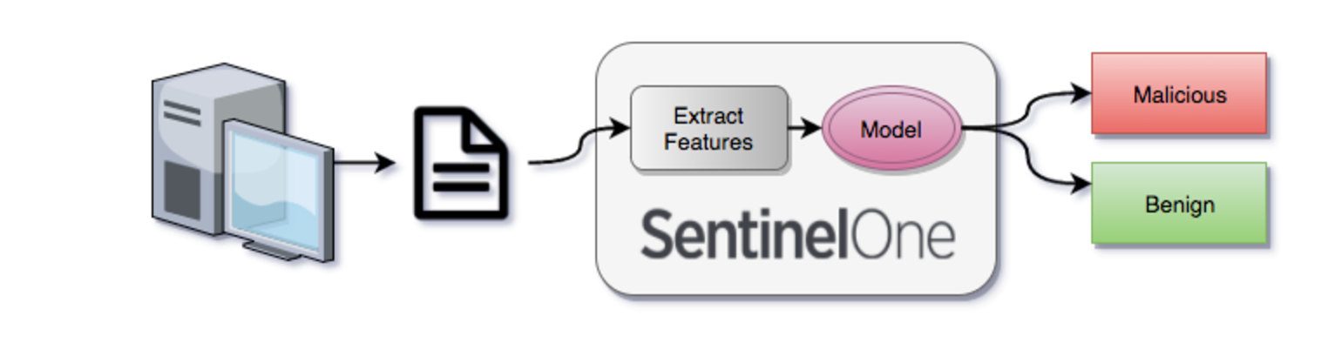
Prediction Phase
Notes:
SentinelOne malware detection engine

Slide 13
Data-Driven & Data-Centric
The best way to select features is manually, based on a deep understanding of the learning problem and what the features actually mean
Model Robustness
Sample Evolution & Classifier Upgrade
Automatic Pipeline & Update Loop
Accuracy >= 99.99% & FP Rate <= 0.001%

Slide 14
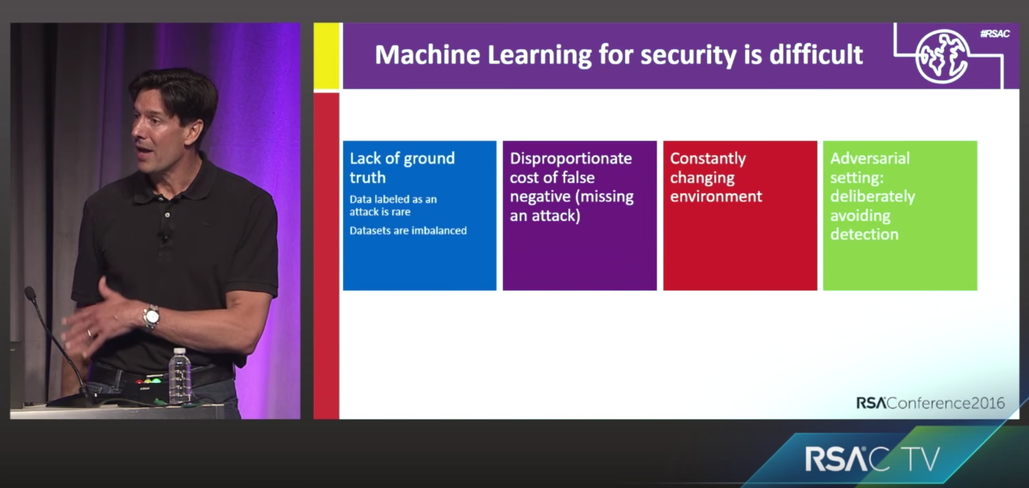
Difficulties

Slide 15
Central Question
What cybersecurity problems can be solved by AI?

Slide 16
Problems that AI can solve – General
Cybersecurity Problem Solved | Typical Vendor | Hotness | ML & Data Mining Alg.
PE Malware Detection | Bluedon & Trustpath | 9 | Random Forest
APK Malware Detection | Google | 7 | Random Forest
PDF Malware Detection | (NA) | 8 | Random Forest
UEBA (See microsoft example) | HP / IBM / Microsoft | 8 | Classification & Clustering
Phishing Detection – email/website | Big Firms | 8 | Classification
Network Intrusion Detection | If necessary | 8 | Classification
Botnets Discovery | If necessary | 8 | Grouping & Clustering
Spam / Ham Classification for email | If necessary | 8 | Classification
Malicious URLs detection | If necessary | 8 | Classification
Any many more ☺
Notes:
Phishing Detection (For how to apply, please see cs259d -> 19)
Network Intrusion Detection (For how to apply, please see cs259d -> 15)
Botnets (For how to apply, please see cs259d -> 2,3)

Slide 17
Bluedon Lightboard 人工智能系列
Bluedon Lightboard 闪光版 UEBA用户与实体行为分析系统
Bluedon Lightboard 闪光版 基于人工智能的僵尸网络检测
Bluedon Lightboard 闪光版 人工智能恶意软件检测引擎
Bluedon Lightboard 闪光版 态势感知平台下的资产行为预测
Bluedon Lightboard 闪光版 基于人工智能的洪水攻击检测

Slide 18
Use Cases Rooted From Bluedon
Case 1: Bluedon AI Firewall – Lack Model Update Feedback Loop
Case 2: Bluedon Situation Awareness System – Lack Model Verification Mechanism
Case 3: Bluedon AI Malware Detection Engine – Lack Practical Practice & Deployment

Slide 19
实验原型 & 产品需求 1
Can detect variants of existing malware
Detail explanation (IoCs) of why the file has been predicted as malicious or benign
Output probabilities for further processing but not just binary value
Perform analysis at pre-execution time
Works on samples with dead C&C servers

Slide 20
实验原型 与 产品需求 2
Works on invalid executables
Computationally inexpensive
数据需求：千万级别病毒样本
数据分析需求：高准确度恶意软件分类引擎，可快速处理{PE,APK与PDF}三种文件类型
在非平衡数据集中，能准确认出TP，即有问题的行为；FP需要极小，因为此将在很大程度上浪费安全分析师的时间

Slide 21
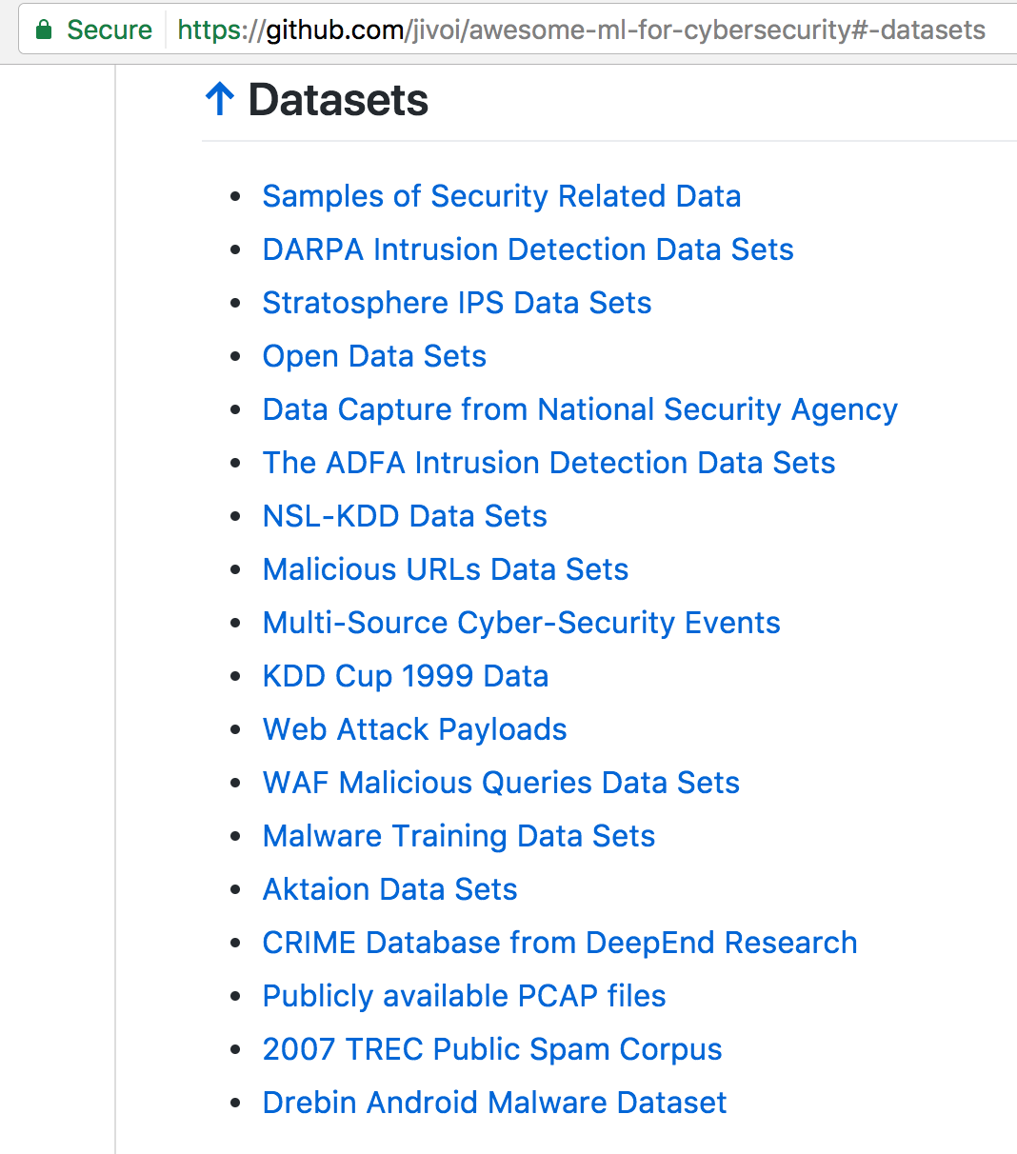
Public Available Dataset

Slide 22
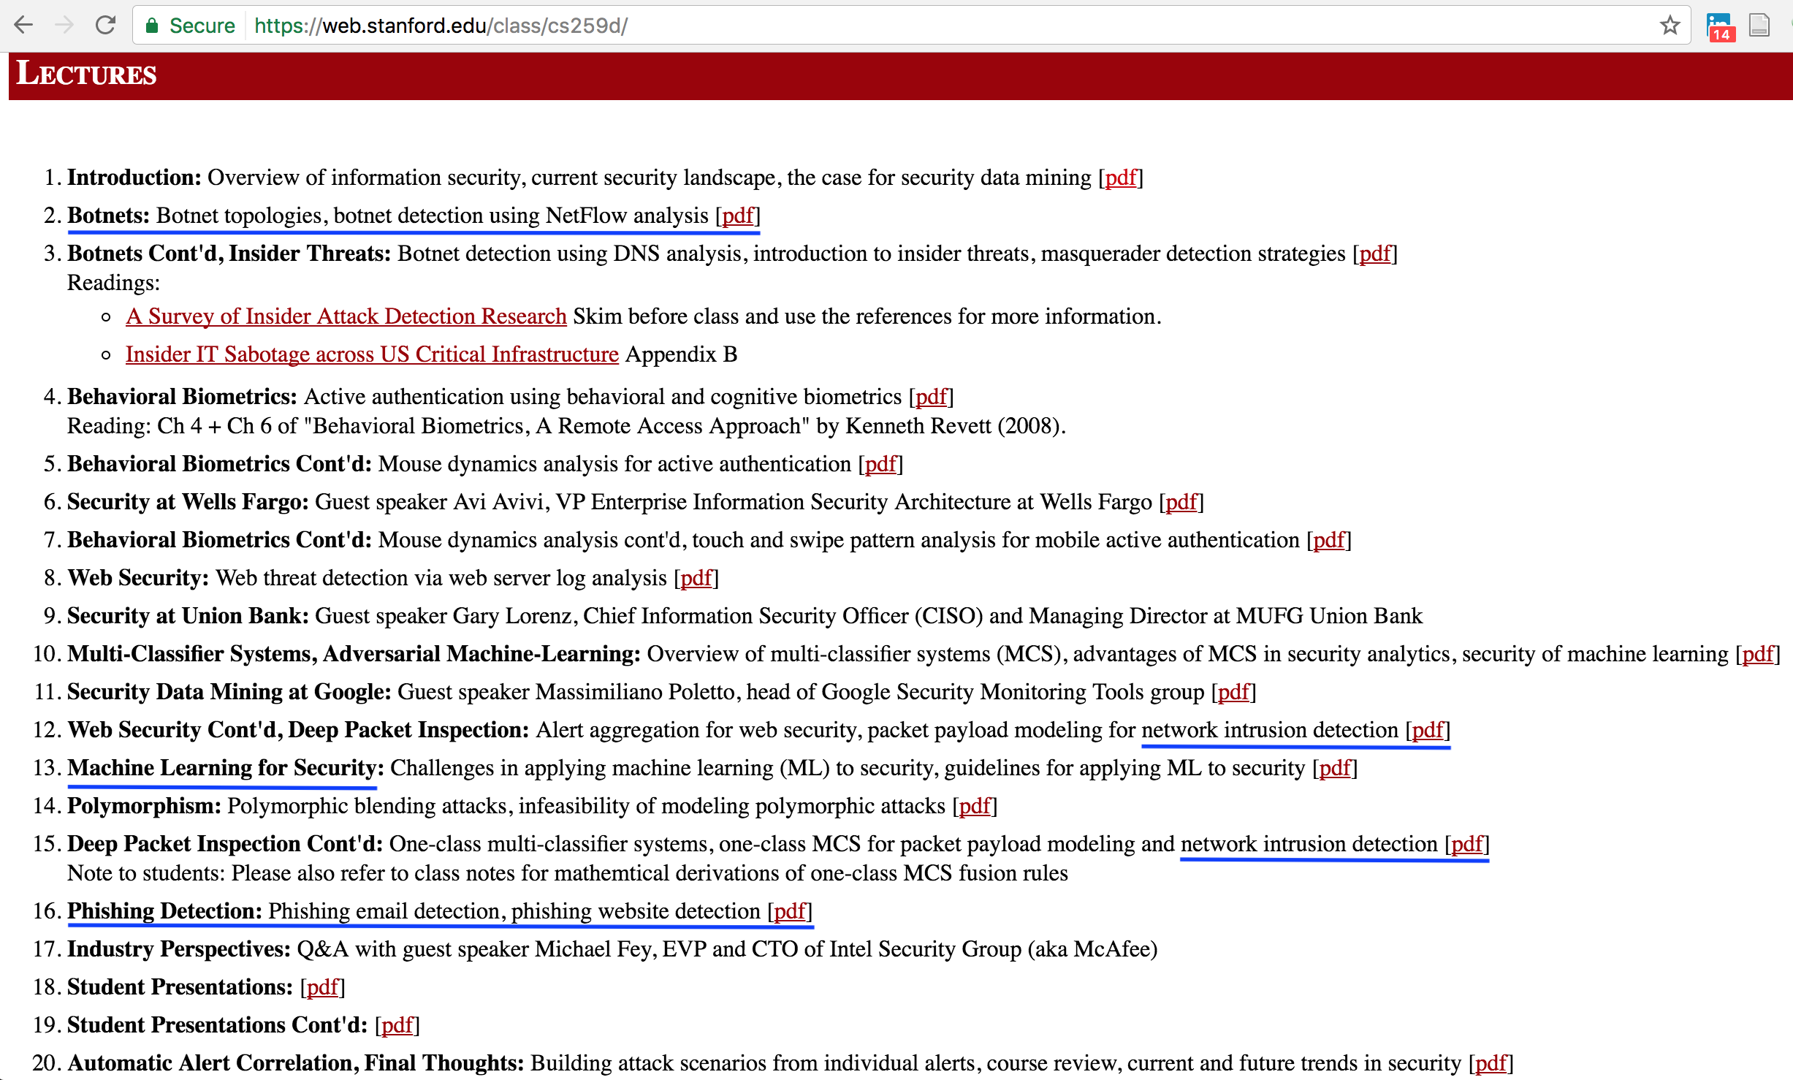
Good Education & Continues Learning – Stanford CS259d

Slide 23
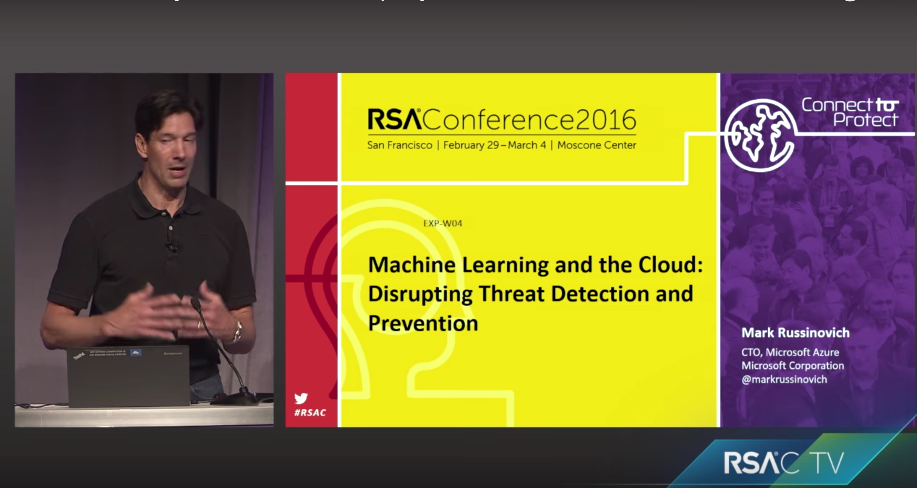
Case Study Recommended Talk – RSA 2016 by Microsoft
Notes:
https://www.youtube.com/watch?v=fRklX97iGIw

Slide 24
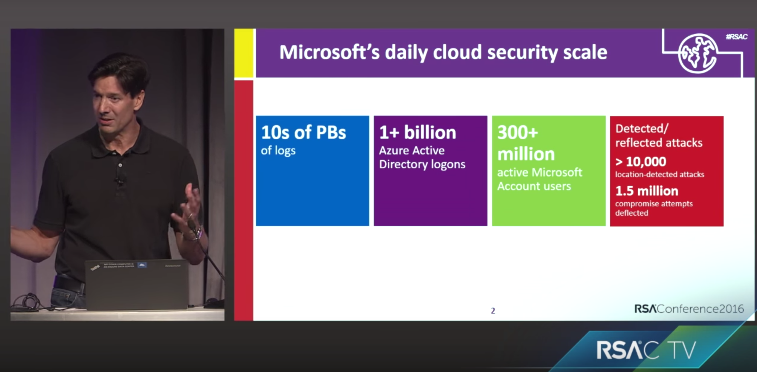
Data at scale in Microsoft’s Cloud
Notes:
The log is important for data analysis

Slide 25
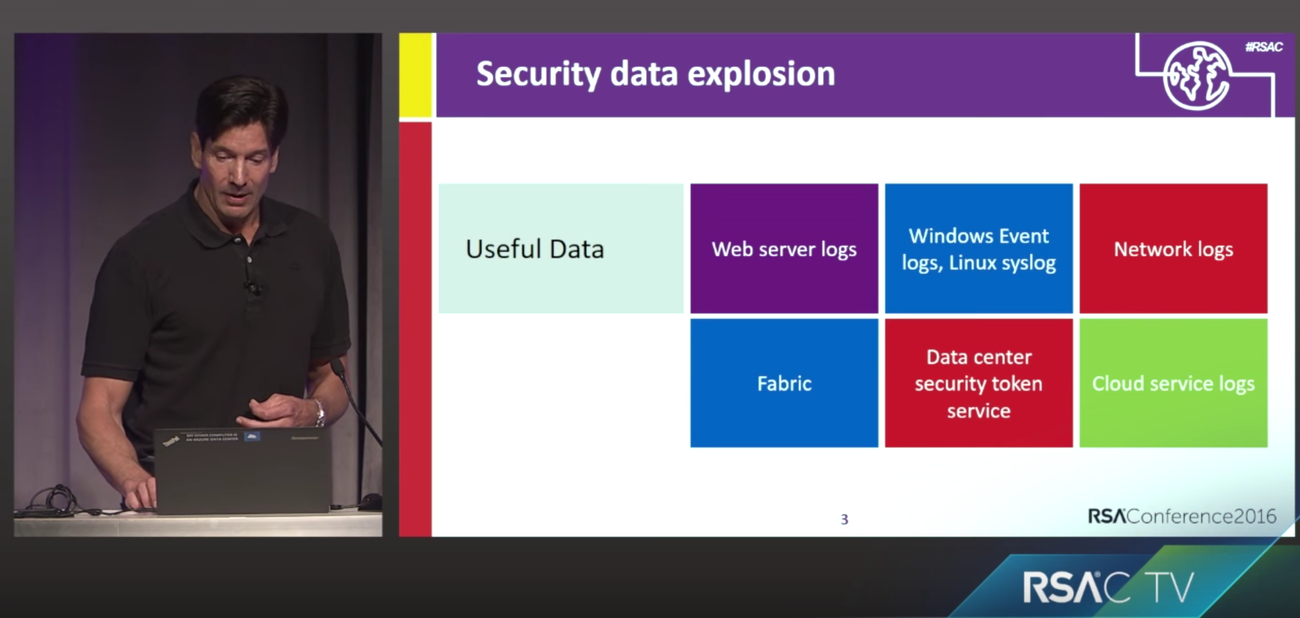
Data Diversity
Notes:
Security event log

Slide 26
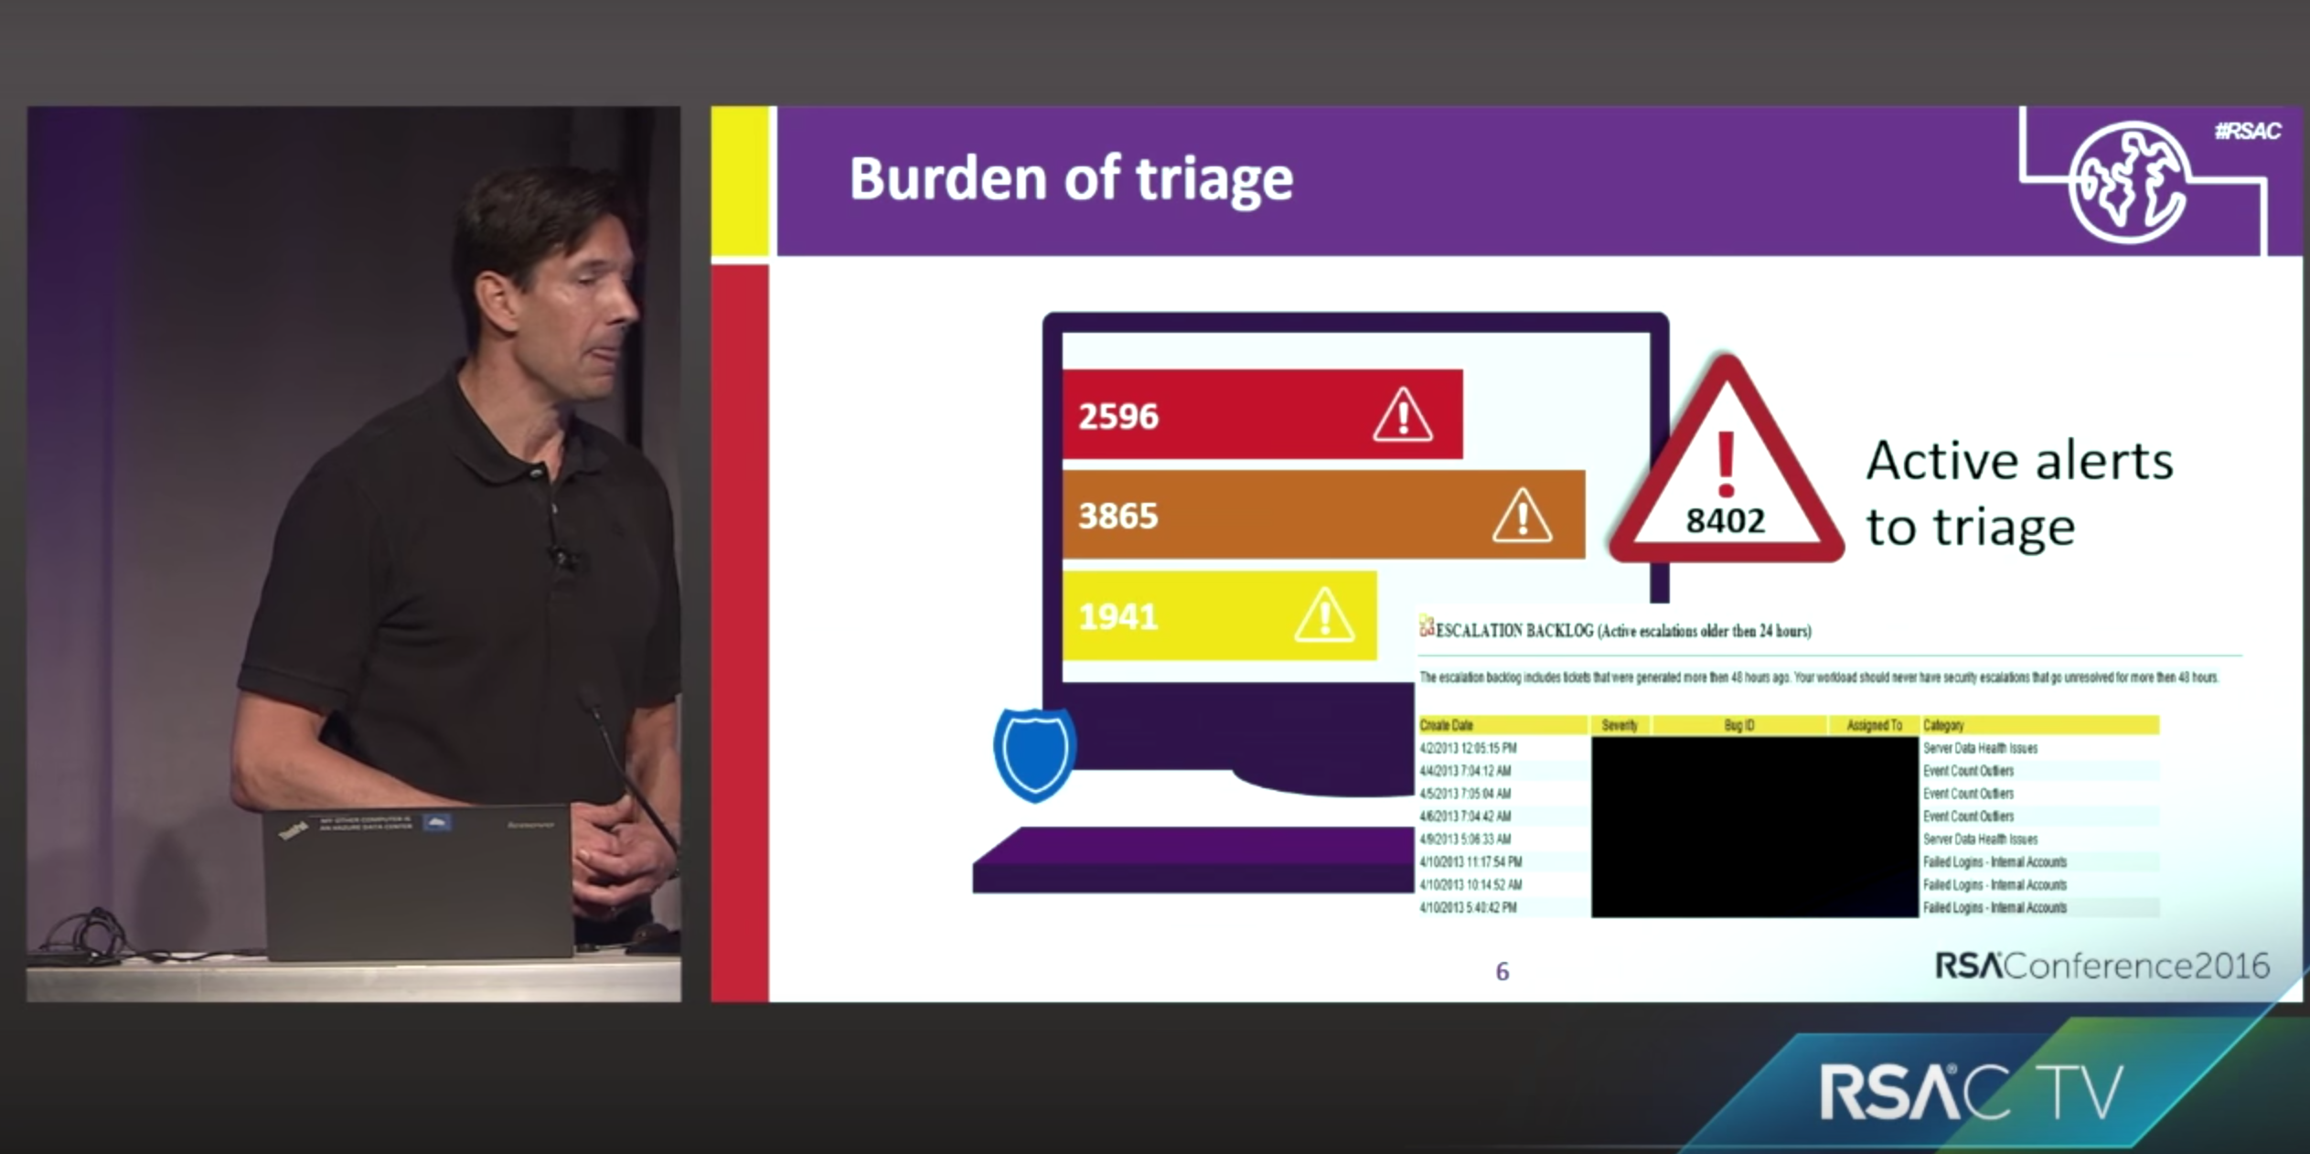
Burden of triage

Slide 27
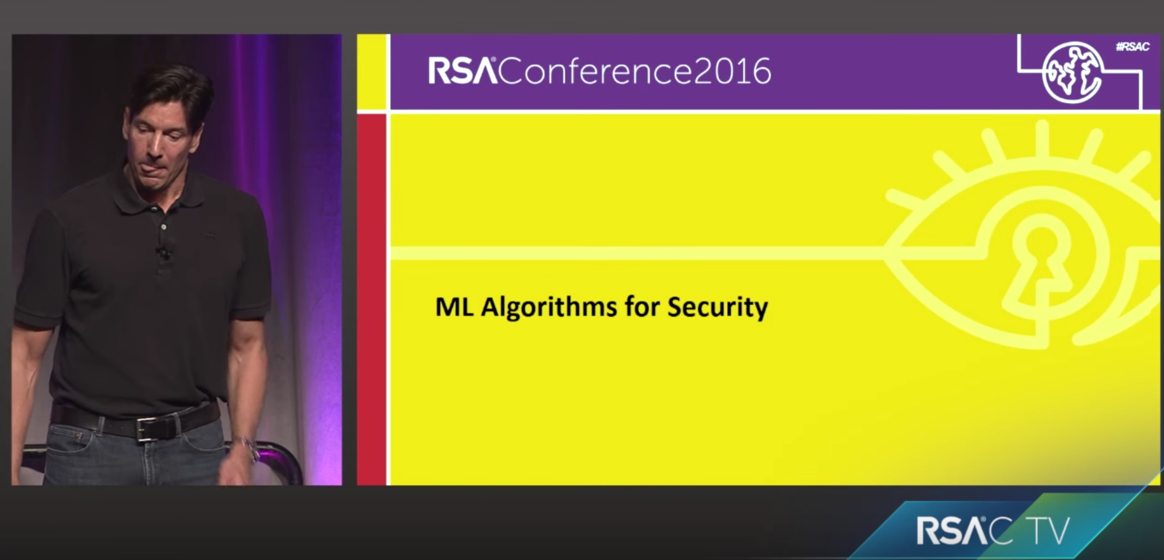
ML Algorithms for Security
Notes:
Infra. Related

Slide 28
Case Study: DevOps anomalies Identify user and service accounts

Slide 29
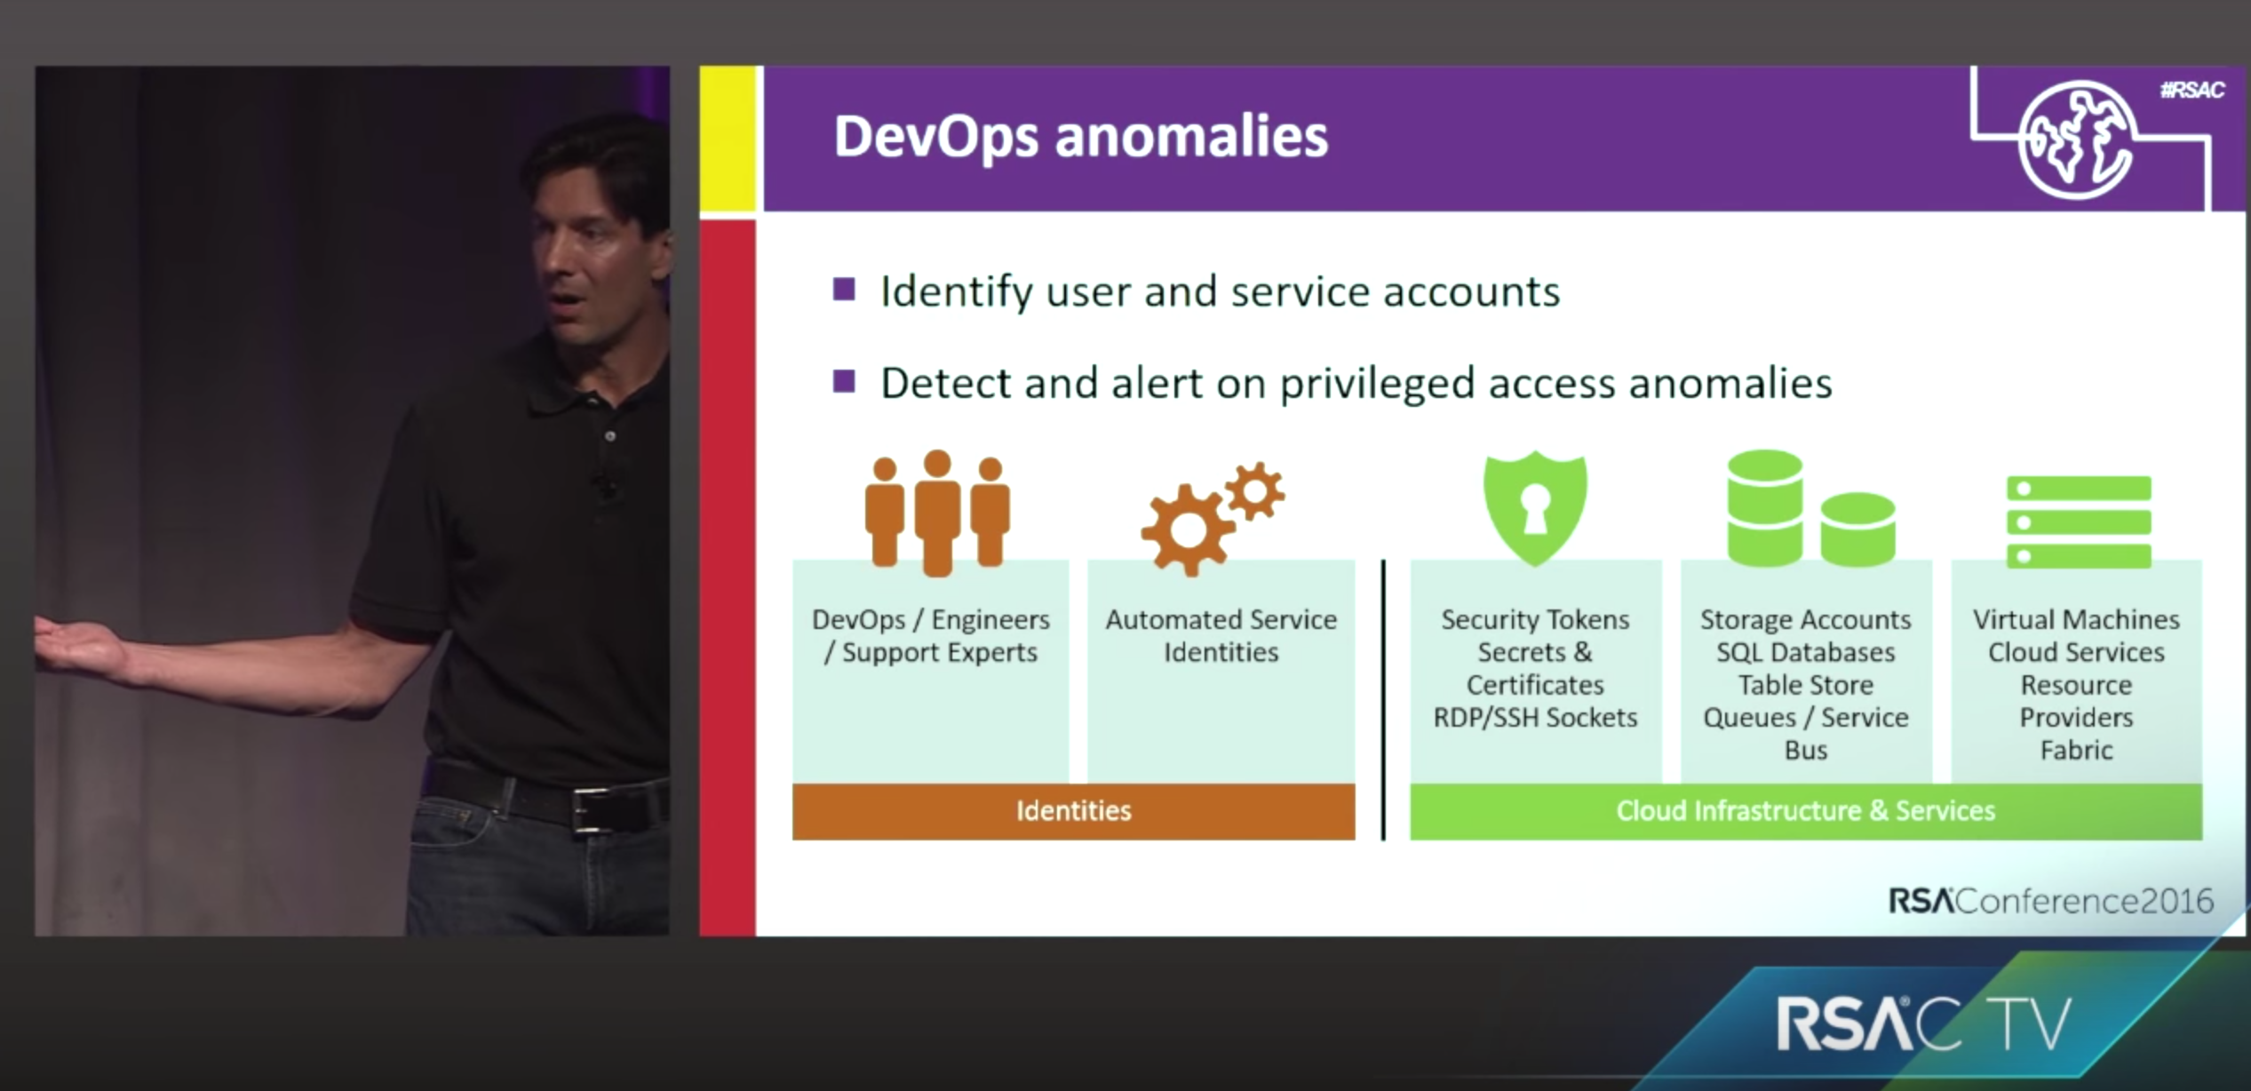
DevOps anomalies

Slide 30
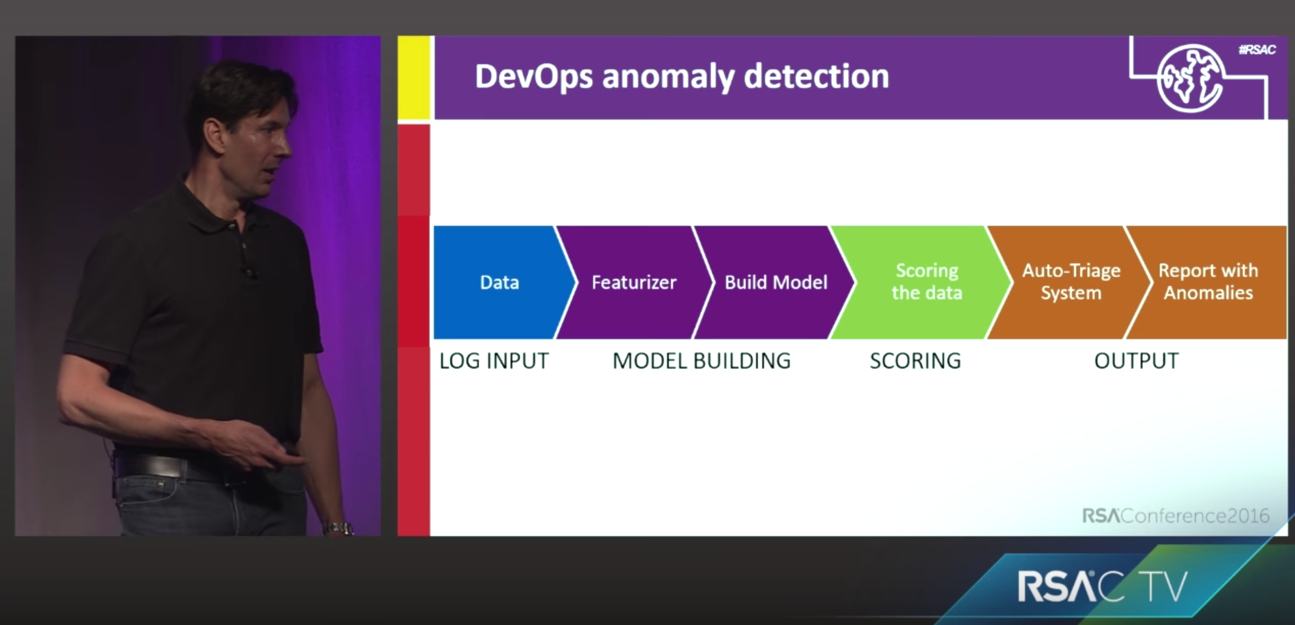
DevOps anomaly detection
Notes:
Record the API called from different components of the infra, and then compute the HASH value on them, this come out to be around 1M features.

Slide 31
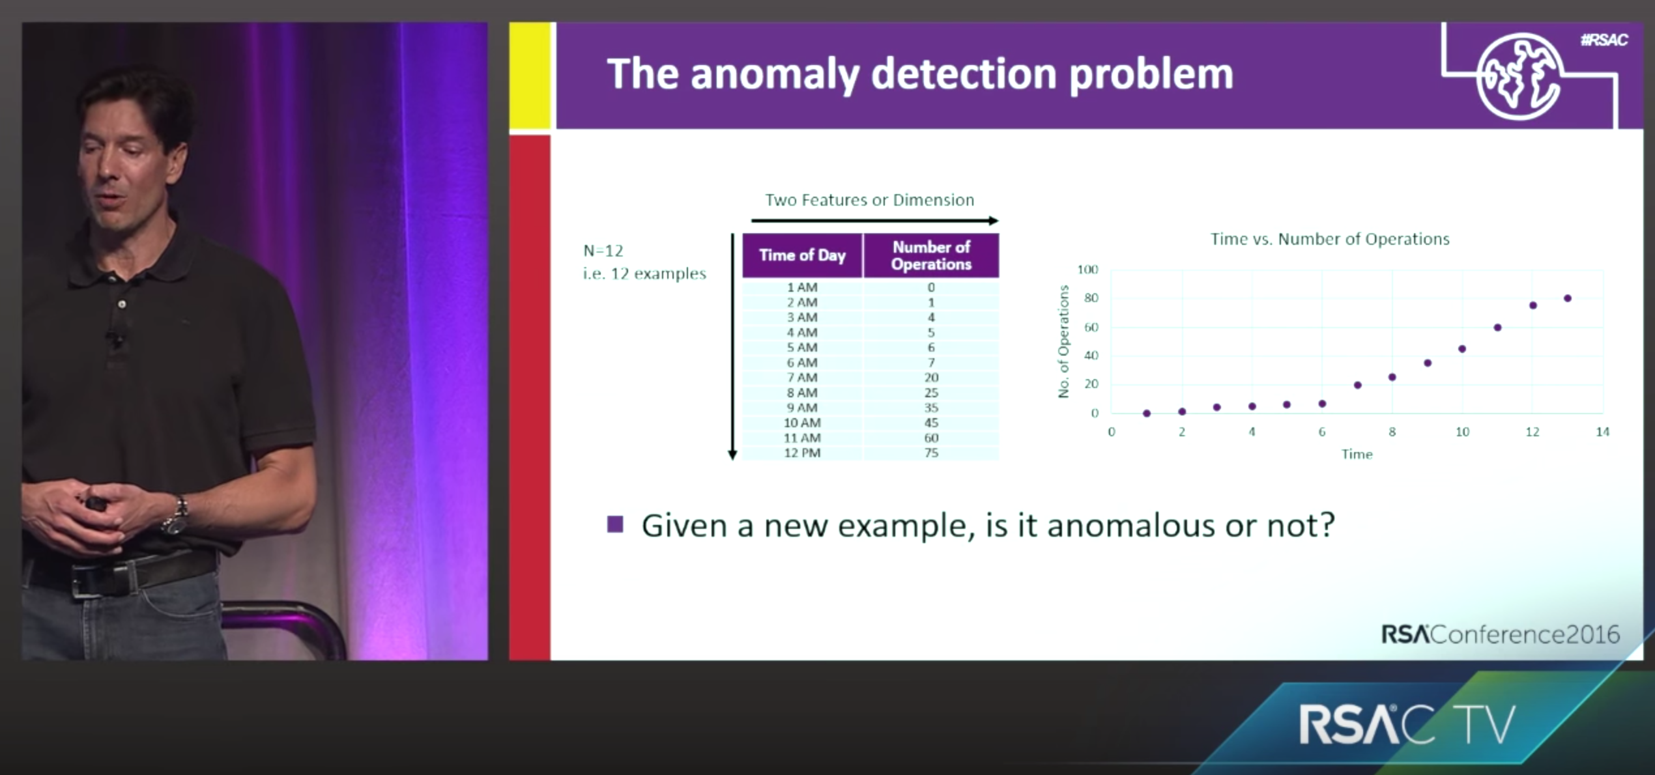
The anomaly detection problem

Slide 32
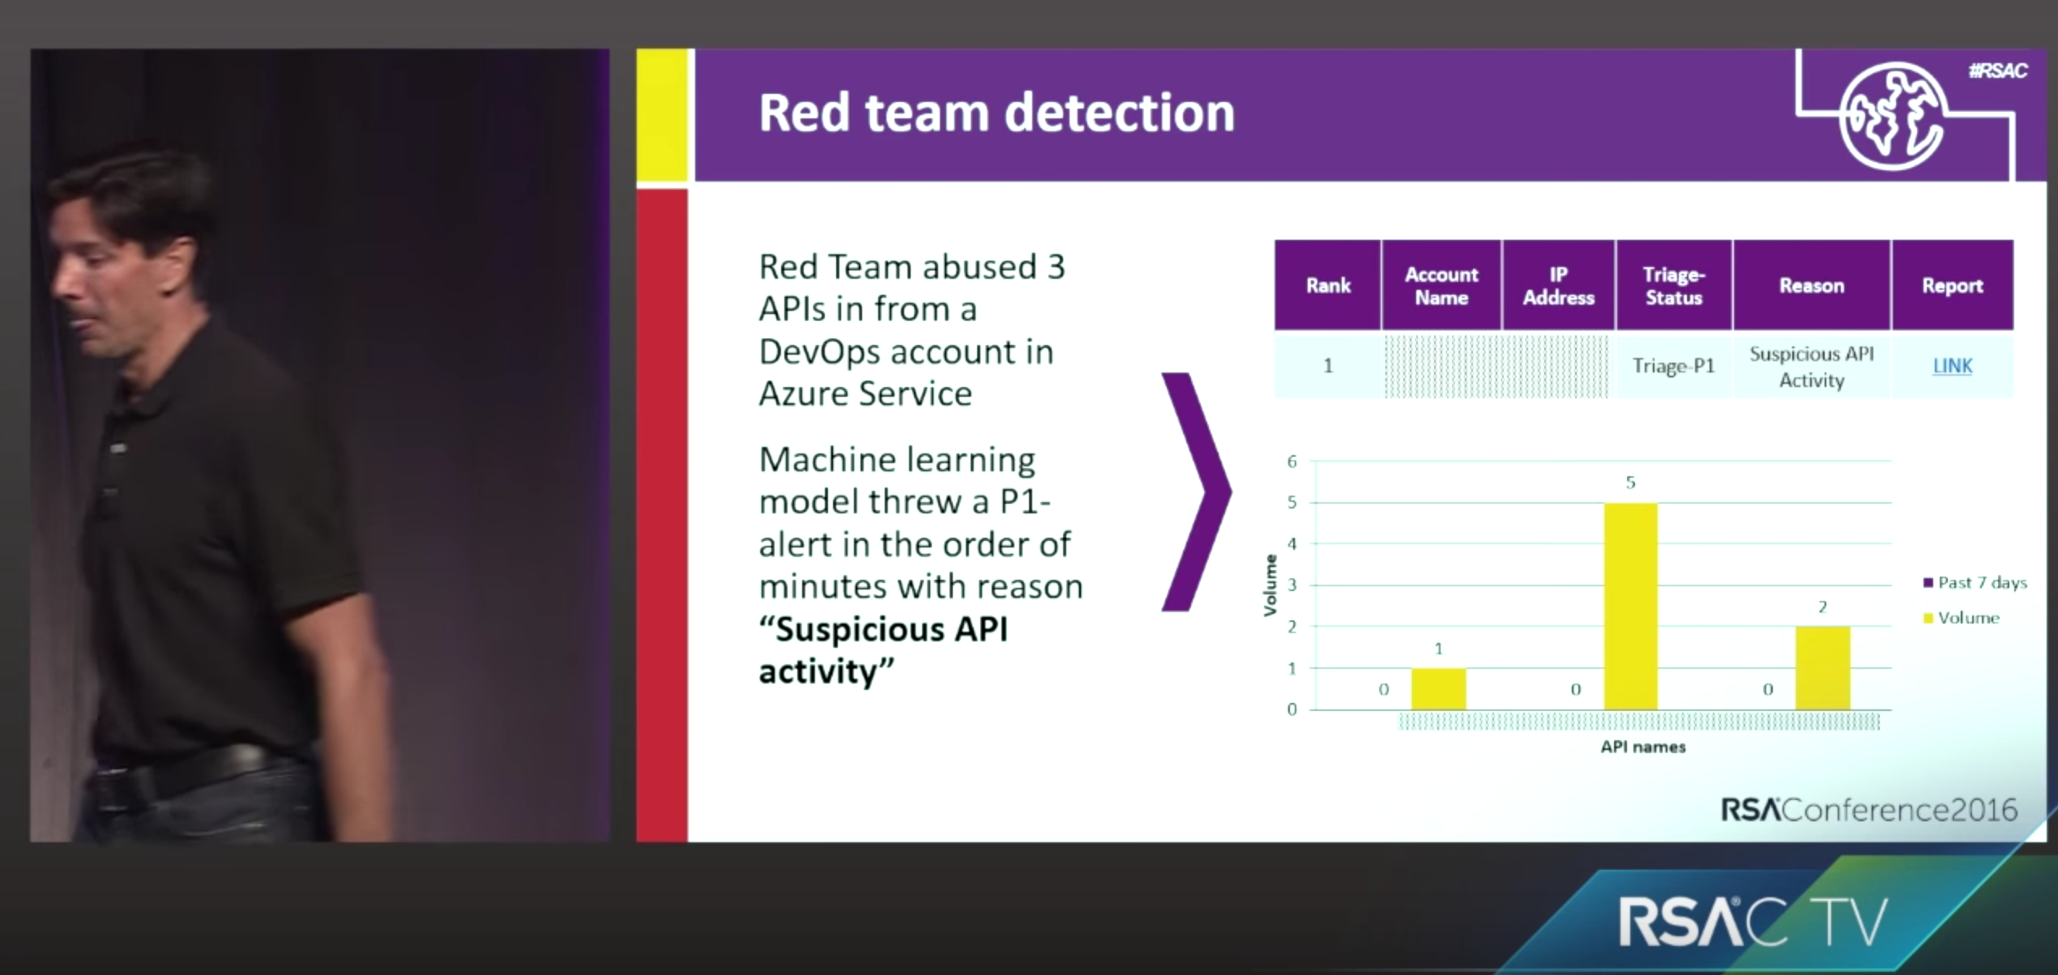
Red Team detection

